Slide 1
Derelict Vessels
Waterways
September 15, 2021
Melissa M. Long, PE
Chief, Environmental Quality Division

Slide 2
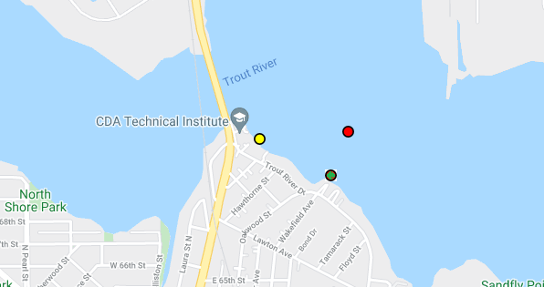
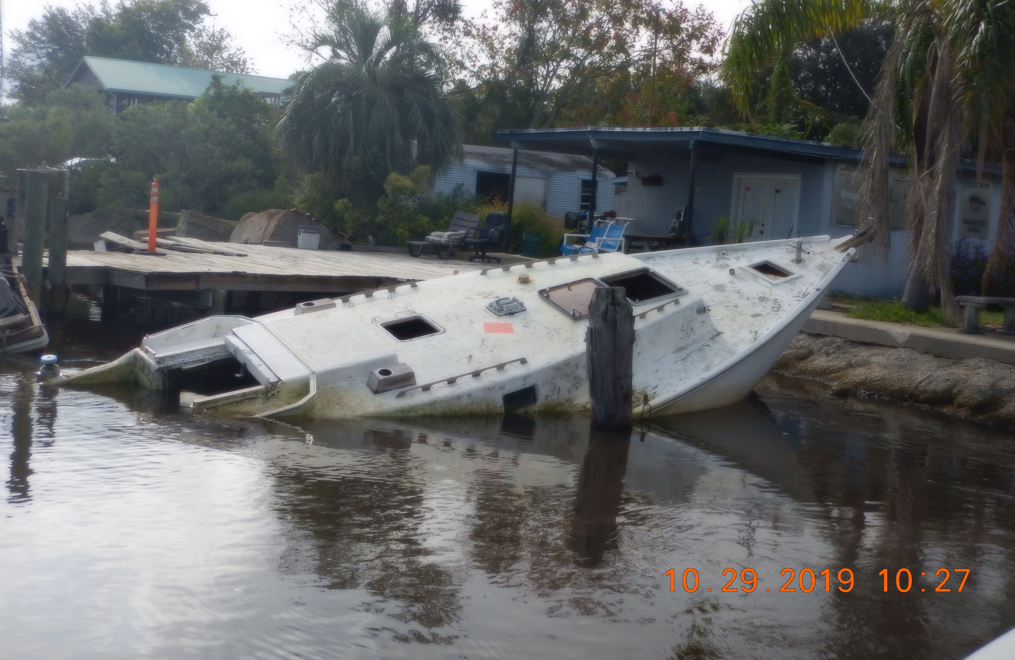
FWC Contract 20367 – Vessel 1
(2021-546)
Case #: FWNC19OFF006785
  Description: 34’ Home Built Sailboat,
  Reg: FL3700KP
  HIN: TXZ185330579
  Location: 30 23.4258(N) / 081 38.54958(W), Trout River Jacksonville, Fl
  Disposal: Dispose of in authorized landfill facility
  Cost Estimate: $8,000

Slide 3
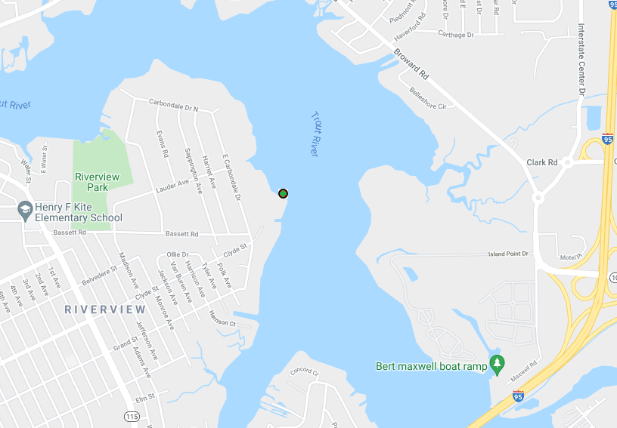
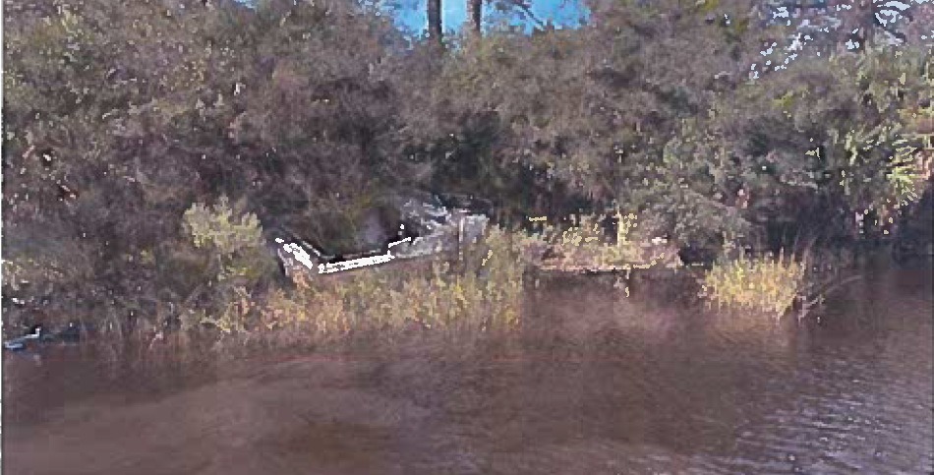
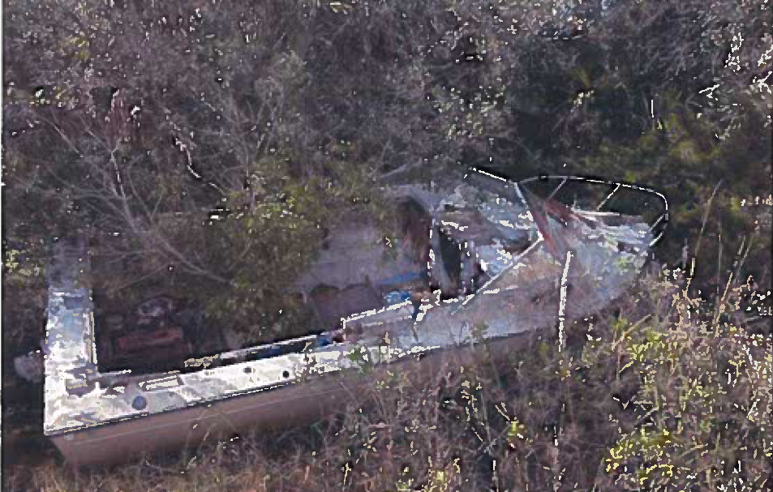
FWC Contract 20367 – Vessel 2
(2021-546)
Case#: FWNC19OFF006927
  Description: 21’ Arrowgls Speedboat,
  Reg: FL0206AS HIN: 399802
  Location: 30 24.73608(N) / 081 40.53282(W), Trout River
  Disposal: Dispose of in authorized landfill facility
  Cost Estimate: $9,000

Slide 4
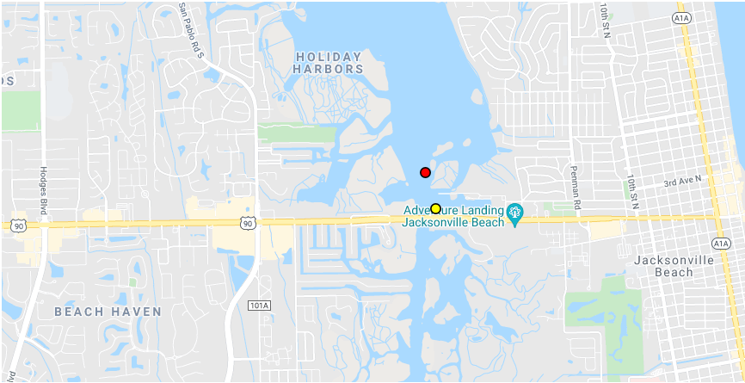
FWC Contract 20317 – Vessel 3
(2021-546)
Case #: FWNC20OFF005354
  Description: 27’ Hunter Marine Sailboat,
  Reg: FL5051DJ HIN: HUN54778M80I-27
  Location: 30 17.50308 (N) / 081 25.2552 (W), North of Beach Blvd Bridge, past beach boat ramp north 100 yards.
  Disposal: Dispose of in authorized landfill facility
  Cost Estimate: $10,000

Slide 5
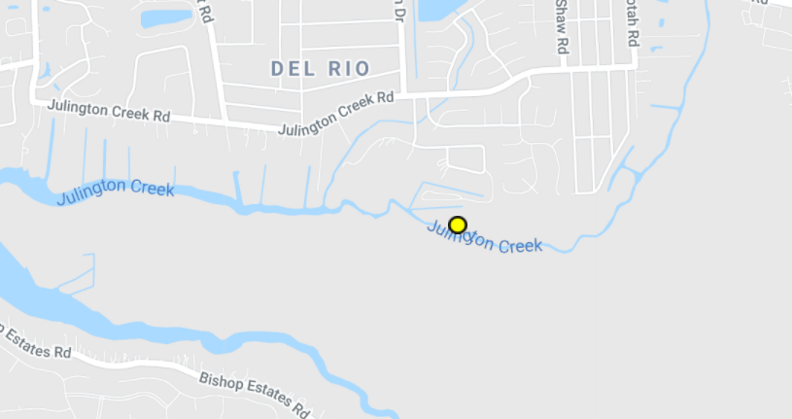
FWC Contract 20399 – Vessel 4
Case #: FWNC20OFF003356
  Description: White, 21’ Unknown make, Reg: Unknown
  HIN: Unknown
  Location: 30 7.85502 (N) /081 34.24002 (W), In the state waters of Julington Creek, northeast of Clarks
  Disposal: Dispose of in authorized landfill facility
  Cost Estimate: $12,500

Slide 6
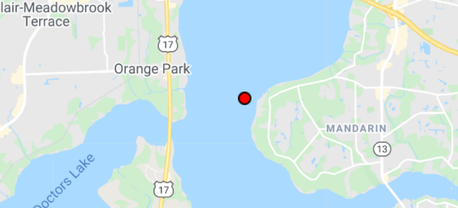
FWC Contract 20399 – Vessel 5
Case #: FWNC20OFF008377
  Description: Green, 21’ Unknown make, Reg: Unknown
  HIN: Unknown
  Location: 30 9.34602(N) /081 40.58298 (W), Mandarin Point in St. Johns River south of Buckman Bridge.
  Disposal: Dispose of in authorized landfill facility
  Cost Estimate: $15,000

Slide 7
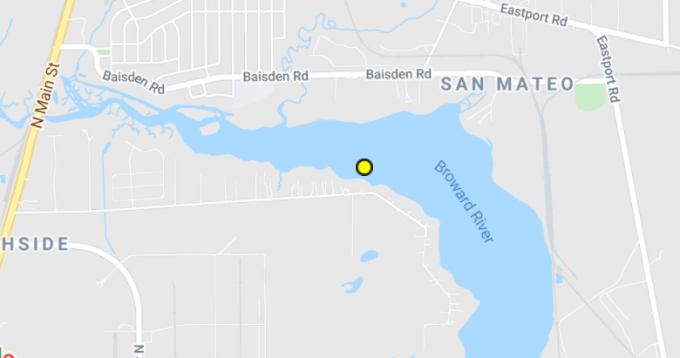
FWC Contract 21034 – Vessel 6
  Case #: JSO 2019-632784
  Description: 38’ White Bayliner Cabin Cruiser, Reg: FL3690NV
  HIN: BLBA41ELF889
  Location: 30 26.043 (N) / 081 37.263 (W), Broward River Behind 1223 Cedar Bay Rd Jacksonville, Fl.
  Disposal: Dispose of in authorized landfill facility
  Cost Estimate: $20,000

Slide 8
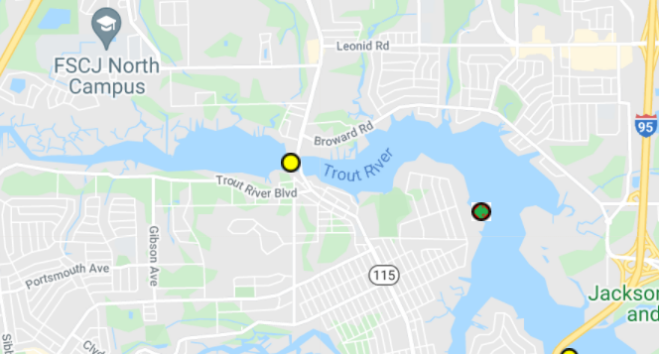
FWC Contract 21086 – Vessel 7
  Case #: FWNC21OFF001865
  Description: Grey, 40’ Shellcraft Commercial Trawler, Reg: FL1996PA
  HIN: SCZF0190D756
  Location: 30 25.02468(N) / 081 41.85642 (W), 9998 Old Lem Turner and the Trout River
  Disposal: Dispose of in authorized landfill facility
  Cost Estimate: $15,000

